Slide 1



SENSORY
ECOLOGY
Crafting Environments: Illuminating, Regulating, and Oxygenating for Optimal Experience.
Guide
Bincy Ponnan
Team
Aditya S
Ameer Ansary
Niranjana JS
Sreehari AR

Slide 2

Sensory Ecology
OVERVIEW
This project aims to develop a sophisticated environmental regulation system utilizing an Arduino Uno microcontroller and a combination of sensors and control mechanisms.
The system is designed to optimize comfort and safety within a room by dynamically adjusting temperature, lighting, and air quality parameters.

Slide 3



Sensory Ecology
MOTIVATION
AND BACKGROUND
Health and Comfort
Indoor environments significantly impact human health, comfort, and productivity.
Energy Efficiency
By implementing smart environmental regulation systems, it's possible to optimize energy usage while maintaining comfortable indoor conditions.

Slide 4

Sensory Ecology
MOTIVATION
AND BACKGROUND
Technological Advancements
The proliferation of sensors, microcontrollers, and IoT (Internet of Things) technologies has made it feasible to develop sophisticated environmental regulation systems at a relatively low cost.

Slide 5


Sensory Ecology
OBJECTIVES
To create an intelligent and sustainable environment that seamlessly integrates innovative solutions to enhance accessibility, optimize resource utilization, promote safety and comfort, and continuously improve the user experience through data-driven decision-making and collaboration with stakeholders.

Slide 6
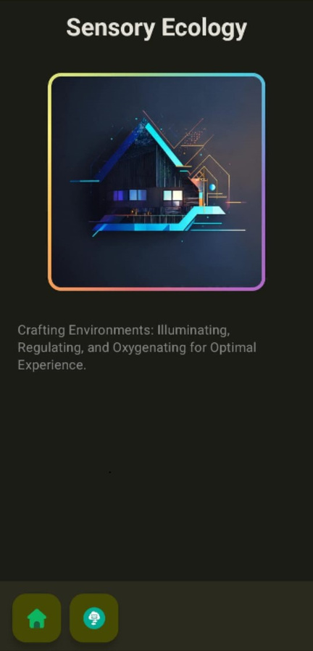
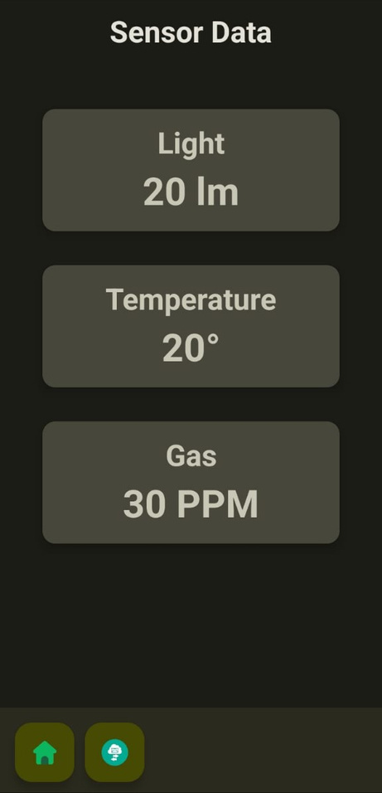
Sensory Ecology
COMPANION APP
We have developed a companion Android App to facilitate real-time monitoring of the room conditions such as temperature, air purity and light intensity.

Slide 7

Sensory Ecology
METHODOLOGY

Slide 8
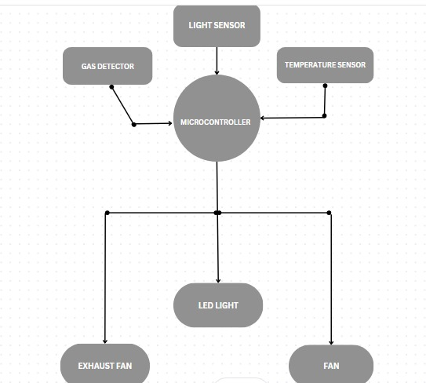
Sensory Ecology
BLOCK
DIAGRAM

Slide 9

Sensory Ecology
STEPS AND
PROCEDURE
Connect the ground (GND) of the sensor board to any of the ground (GND) pins on the Arduino.
Connect the SCL (Serial Clock) pin of the sensor board to the corresponding SCL pin on the Arduino. In this case, it is pin A5.
Connect the SDA (Serial Data) pin of the sensor board to the corresponding SDA pin on the Arduino. In this case, it is pin A4.

Slide 10
Sensory Ecology
ALOGRITHM
Setup
1. Initialise serial communication at 9600 baud.
2. Initialize BH1750 light sensor.
a. If the sensor is not found, print "No BH1750 sensor found!" and enter an infinite loop.
3. Set pins 3-10 as OUTPUT for LEDs.
4. Set pin 13 as OUTPUT for temperature control relay.

Slide 11
Sensory Ecology
ALOGRITHM
Loop
1. Light Sensor:
a. Start BH1750 sensor.
b. Read light intensity in lux.
c. Print "Light Intensity: " followed by lux.
d. Control LEDs based on lux:
i. If lux > 1000:
- Turn off LEDs 3-9.
- Turn on LED 10.
ii. Else if lux > 500:
- Turn off LEDs 3-8.
- Turn on LEDs 9-10.
iii. Else if lux > 100:
- Turn off LEDs 3-7.
- Turn on LEDs 8-10.
iv. Else if lux > 50:
- Turn off LEDs 3-6.
- Turn on LEDs 7-10.

Slide 12
Sensory Ecology
ALOGRITHM
v. Else if lux > 20:
- Turn off LEDs 3-5.
- Turn on LEDs 6-10.
vi. Else:
- Turn on LED 3.
- Turn off LEDs 4-10.
2. Temperature Sensor:
a. Read temperature using DHT11 sensor.
b. Print temperature.
c. If temperature reading is valid:
i. If (temperature - ROOM_TEMP) >= 1:
- Print "Temperature changed to " followed by temperature.
- Turn on the relay (pin 13 HIGH) to turn on the fan.
ii. Else:
- Turn off the relay (pin 13 LOW) to turn off the fan.
d. Else:
- Print error message.

Slide 13
Sensory Ecology
ALOGRITHM
3. Gas Detector:
a. Read air quality in ppm using MQ135 sensor.
b. Print "Air Quality: " followed by ppm and "ppm".
c. If ppm > 100:
- Turn on the relay (pin 13 HIGH) to turn on the fan.
d. Else:
- Turn off the relay (pin 13 LOW) to turn off the fan.

Slide 14
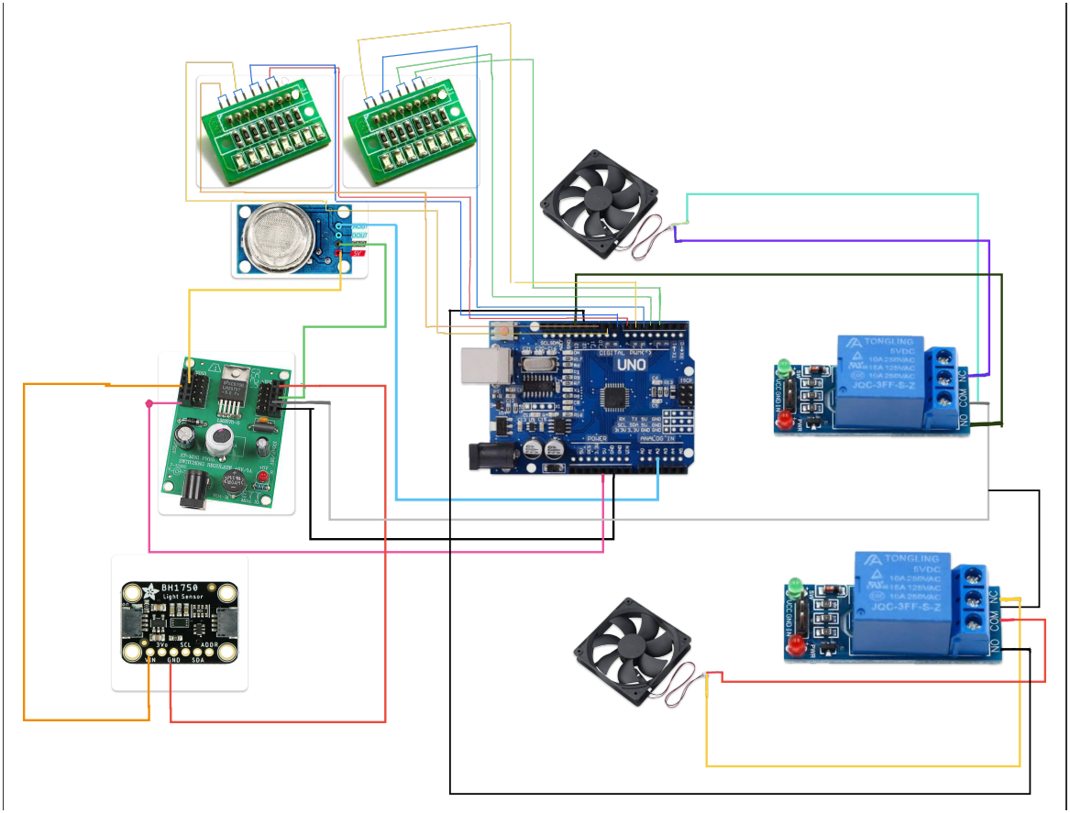
Sensory Ecology
HARDWARE
DESIGN

Slide 15

Sensory Ecology
BH1750 Light Sensor
Arduino Uno
Jumper Wires
Led Strip
Breadboard x2
Fan x2
Temperature Sensor DHT11
Relay x2
CO2 Sensor
COMPONENTS
REQUIRED

Slide 16
Sensory Ecology
BH1750 Light Sensor - ₹500
Arduino Uno - ₹600
Jumper Wires - ₹50
Led Strip - ₹200
Breadboard x2 - ₹200
Fan x2 - ₹260
Gas Detector - ~₹500
Temperature Sensor DHT11 - ₹200
Relay x2 - ₹60
BUDGET

Slide 17
Sensory Ecology
REFERENCES
https://learn.adafruit.com/adafruit-bh1750-ambient-light-sensor/arduino
https://projecthub.arduino.cc/arcaegecengiz/using-dht11-12f621
https://projecthub.arduino.cc/m_karim02/arduino-and-mq-135-gas-sensor-with-arduino-code-0385af https://forum.arduino.cc/t/connection-uno-with-esp01/1198688

Slide 18


